Slide 1
IDEATHON 2020
BY:
YATHISH NV
MAHANASH KUMAR
Narasimha Jwalapuram

Slide 2
Smart Solutions of Waste Water and Air Quality

Slide 3
Case Study, Analysis, Detection using IOT and Solution for Waste water management

Slide 4
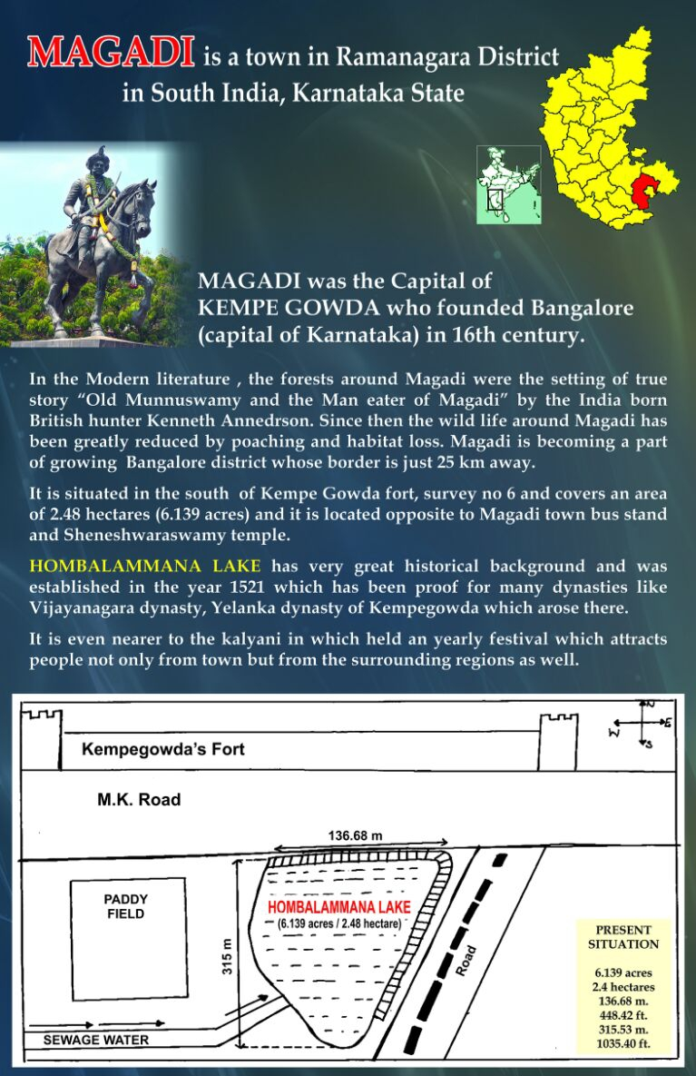

Slide 5
Introduction
As today, in this fast-growing world, human greediness has caused ecological imbalance in the environments and due to that natural calamities like floods (currently active), earthquakes occurred and will be occurring again and again.
So the main causes are deforestation and air pollution (causing global warming) and others are human induced activities like mining, industrial exploitation, etc
Since it is high time to bring smart solutions for this.

Slide 6
Survey
To analyze various factors that has significant importance in cause and control in air quality and water quality, we have conducted two surveys for analysis of the same.
Our main emphasis in the ideation and surveys has been
Biological system to process the sewage
Smart systems to analyze the water quality index

Slide 7
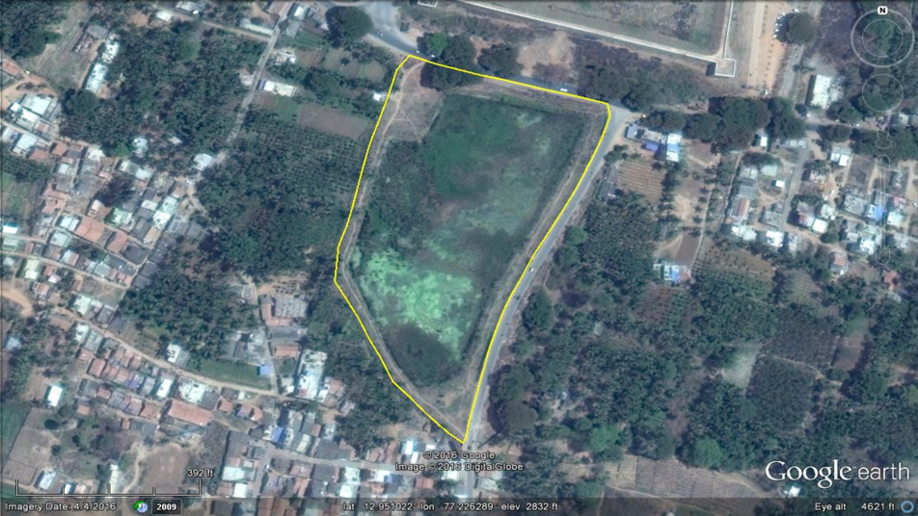
Issues Faced
1. As the sewage contaminants from the 200 houses nearby are let into the lake which causes algal growth, water quality deterioration, Nutrient enrichment
henceforth leading to eutrophication and degradation of the quality of the lake.
2. This also caused issues with the neighbors, as it leads to the accumulation and release of H2S causing the pungent odor.
3. Reduced oxygen amount leads to a decline in the aquatic population. Also, lead to an acceleration in the rate of mosquito breeding and an increase in the rate of mosquito-borne diseases.
satellite image of Lake

Slide 8
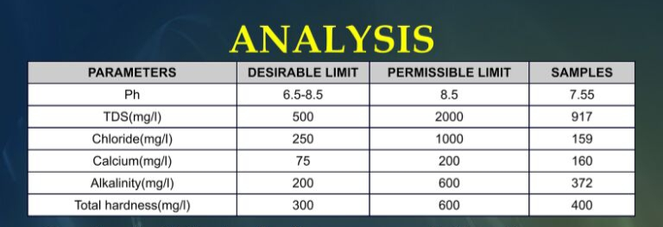
The following water quality analysis was carried out at the Centre for Ecological Sciences dept. lab of IISc as per the ISI standards

Slide 9
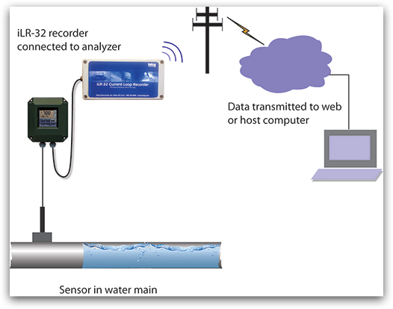
IOT based Water Quality System with Lab analysis Report

Slide 10
Components for Building water quality system.
Arduino Mega
Bolt IOT WIFI Module
Water Level Sensor
pH Sensor
Turbidity Sensor
TDS meter
LCD Display Board
LEDs,LM35,Humidity sensor,Buzzer,Jumper wires

Slide 11
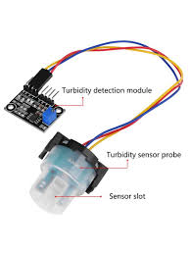
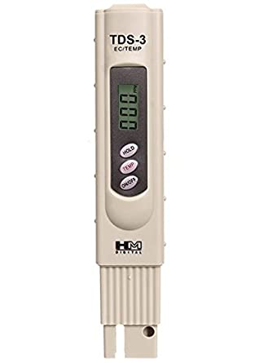
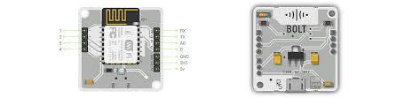
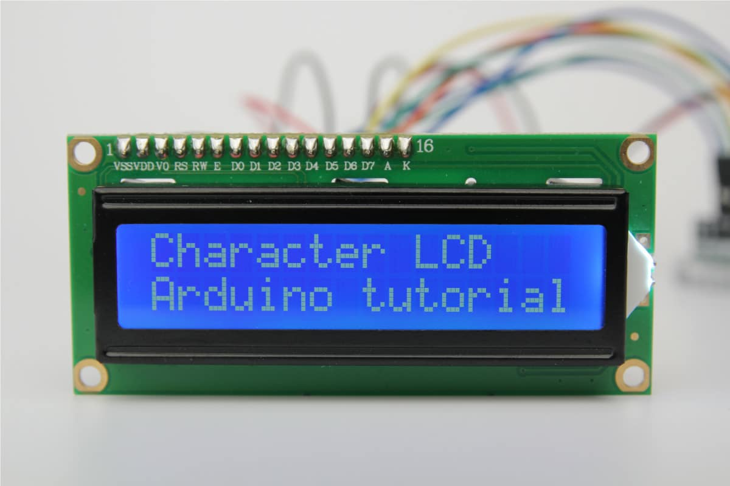
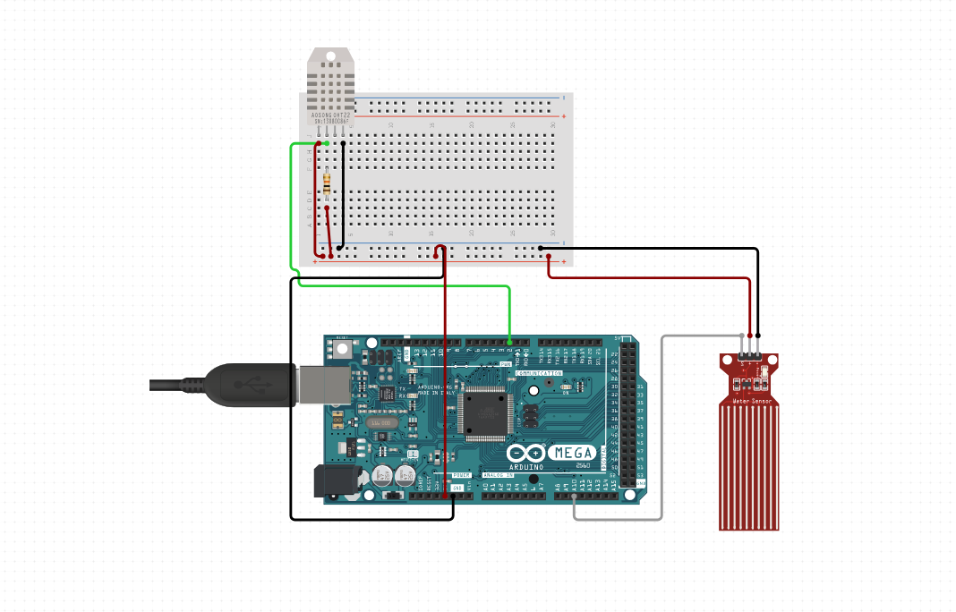
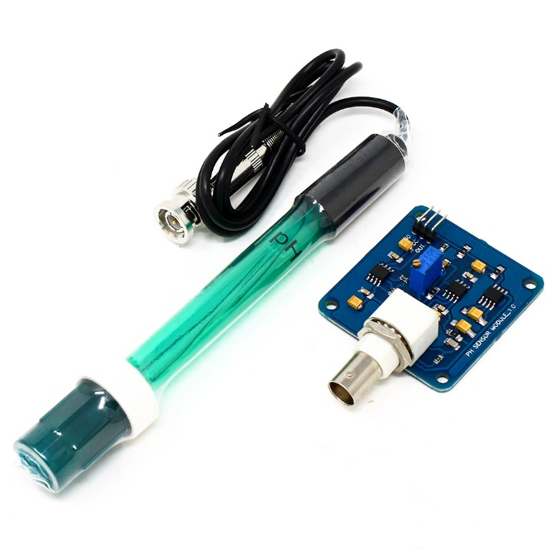
TDS meter
LCD Display
Bolt wifi Module
Arduino Mega with humidity and water level sensor
pH Sensor

Slide 12
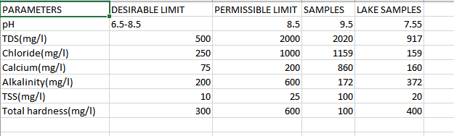
Data collected from these sensors is sent to cloud via wifi either to Thing speak server or Firebase storage and csv file is prepared and continuous monitoring is done and Alert system is done through Sms or telegram message and sound from buzzer indicating good fit for portable water.
Sample CSV table:

Slide 13
So we developed a solution to address two major problems, which were:
Degradation of Lake
The treatment of sewage water
The idea is to incorporate multiple technologies together in a single system so that a complete solution could be provided that can decontaminate the site economically in a time-efficient manner as well as improve the quality of the site through restoration.
Nano-Bioremediation method was incorporated for remediating lake as It has several advantages over physicochemical methods such as
high selectivity
specificity
cost and energy efficiency
minimal requirement.

Slide 14
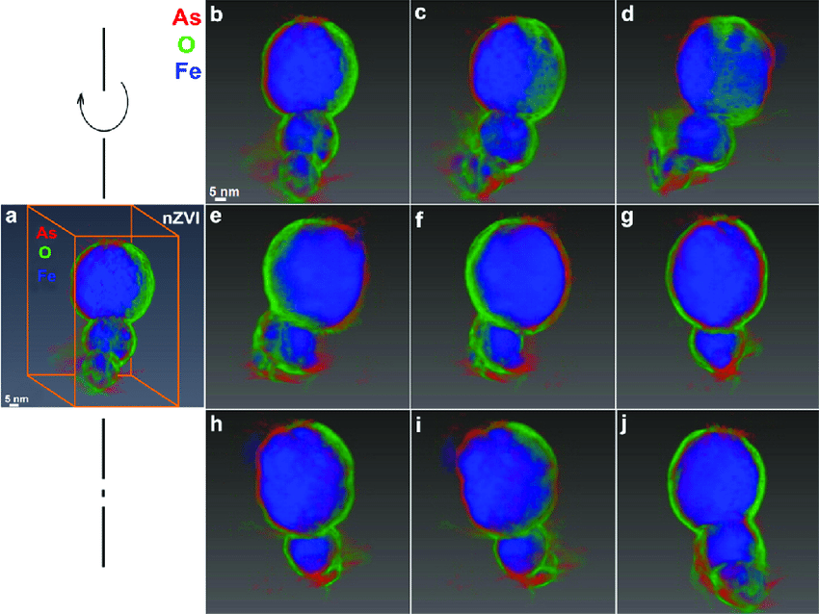
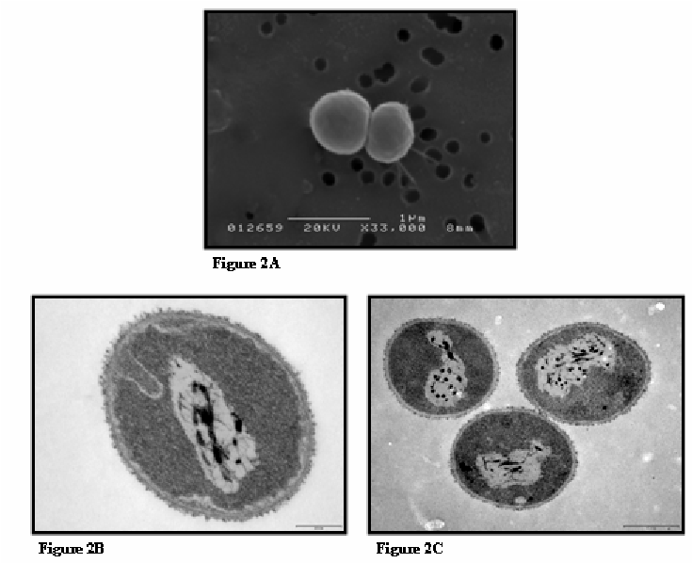
Nanoscale zerovalent iron (nZVI) has shown enormous potential in contaminant reduction and can be successfully used in lake remediation .
So, the incorporation of Paracoccus sp. strain YF1 in nZVI helps in more efficient remediation of. Nitrates.
Under optimal conditions, nZVI-CA beads showed 91.35% removal, and for biofilm-coated nZVI-CA beads, the removal percentage was found to be 97.84%
3D chemical mapping of spent nanoscale zerovalent iron after reactions with arsenate. (a) 3D elemental distributions of Fe (blue), O (green), and As (red). (b−j) Series of mappings acquired from spent nanoscale zerovalent iron reacted with arsenate in the tilt range of +64° to −64°. The sample was from a batch reactor containing 10 mg As(V)/L and 0.5 g/L nZVI after 48 h. A corresponding video of the 3D tomography can be found in Movie S1
Scanning-electron micrograph of control Paracoccus sp. (A) . Ultrathin sections of strain DE2007 from pristine cultures (B and C) . Scale bar indicates 200 and 500 nm, respectively.

Slide 15
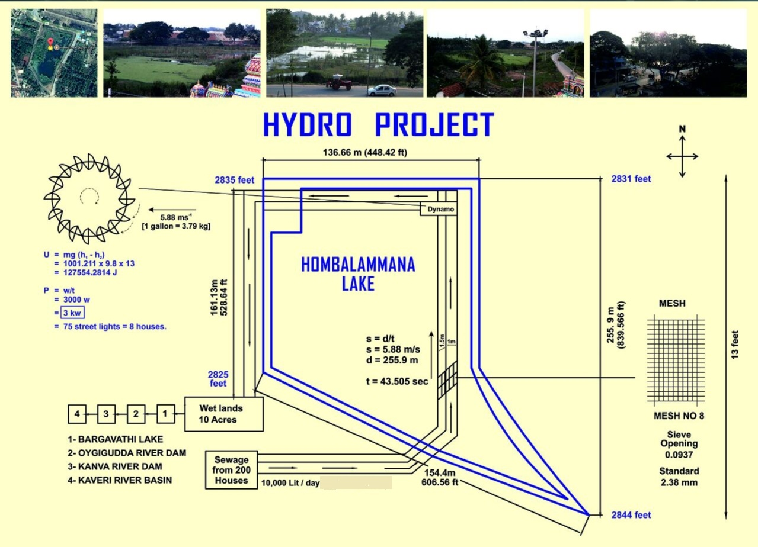
U = mg(h1-h2)
=10012.11x9.8x4
=392474.7 J
Power generated
= 5KW

Slide 16
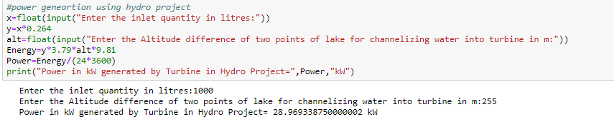
Sample Power Calculation

Slide 17
Air Quality Monitoring
Analysis of Greenery in Bengaluru, Detection and Calculation of Air Quality index, IoT based Alert system, Smart Solution for Air pollution

Slide 18
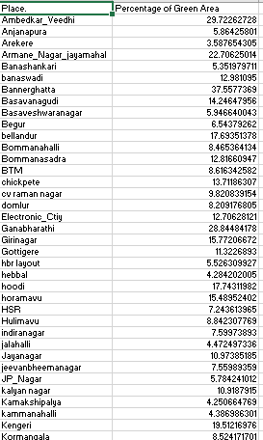
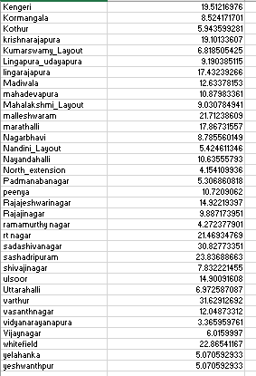
Green Percentage of Bengaluru

Slide 19
Need of Air Quality System
We found the green percentage of every area in Bengaluru which is considered as Garden city of India has very low percent that falls in the range of [5-38] percentage.
Trees are reducing day by day, due to housing and layouts increase with high population density, there by creating air pollution.
Air pollution has caused serious health issues for people.
So there is need to increase greenery for environmental sustainability in Bengaluru and requirement of air quality monitoring system to create awareness among people.

Slide 20
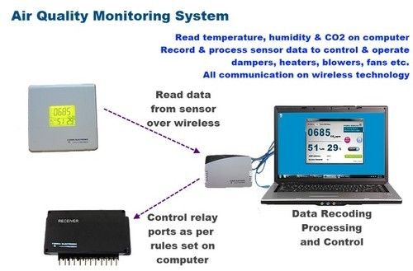
IOT based Indoor Air Quality Monitoring

Slide 21
Components required for Air Quality Monitoring
Arduino Mega/AmebaSPI
Bolt WIFI Module
PMS 7003 and PMS 5003 sensors: measures air quality.
DHT22 Humidity sensor and Temperature sensor
LCD display
LDR ,LEDs,Buzzer,Jumper wires,etc

Slide 22
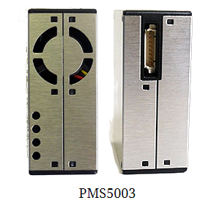
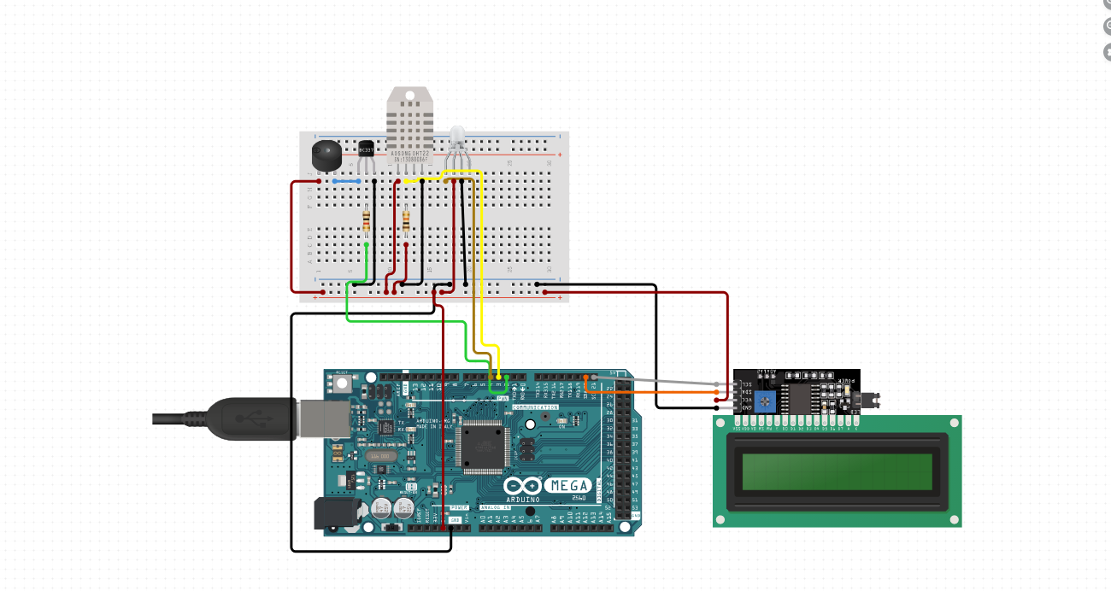
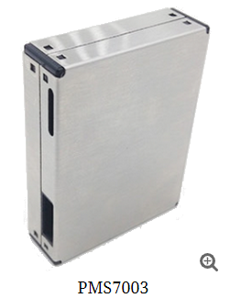
Arduino Mega with DHT22,buzzer and LCD display sensors

Slide 23
Working of Air Quality System
First temperature and humidity is monitored by DHT22 sensor and then air quality index is measured by PMS sensor and displays it on LCD and sending the data using Bolt WIFI module to cloud and parameters like temperature,humidity,intensity of light and finally air quality index and table is created and analysis is done and Alert system is built if certain threshold is exceeded and sound of buzzer is heard indicating poor air quality index.

Slide 24
Solutions for Air Pollution Decrease
Air quality monitoring system at every regions of Bengaluru and display it like one that is already in present in central town hall.
Make sure all the vehicles have emission test must be checked regularly by traffic police and creating awareness to the people by sending the air quality index and reviews and insights through the mobile application.
Also as survey shown green percentage is very less in Bengaluru, one of the method is to regulations of ban certain pollutants and increase planting of trees smartly by making strict implementation of planting trees/garden by every households.
Since we are facing Covid 19 pandemic so maintaining good health is important hereby there is a need of balanced ecosystem with pure oxygen. Hence right time to implement these rules.

Slide 25
Market Research
There are many companies that provide these services either as NGOs or as
Govt. funded projects or as initiatives like
Green Solutions (India) Private Limited
Green Solutions Ltd. | Renewable Energy Services
Go Green Solutions Pvt. Ltd. – For better world
This provides a sanitizer tunnel for covid protection and waste
management system but does not provide air quality system which is a
added bonus to our project.

Slide 26
Clients For Our Project
All scale industries dealing with waste water effluents
Sewage power plant and industries
Microprocessor Industries for Raw materials
Government of India
Citizens of India

Slide 27
Designing of Product and Marketing
Integration of two IOT systems into Single development kit.After the basic prototype of the model is done using breadboard, Arduino and other sensors and components we can test our design as a basic step.
After this step, we can convert this design into PCB design or schematic using software like auto CAD etc which can help in another simulation and testing of the circuit
This design is then printed on to boards which are generally made of copper clad aluminium wires and soldering can be done using solder. .Then the required components can be soldered on to the board according the schematic using solder iron[9:09 pm, 23/10/2020] Narshima: Then we get the final prototype of our desired circuit
Cloud server and database used for storage of data like Thing speak or firebase
Building the Smart Phone application as end product to users across the global and keep them updated with Warnings and alerts.
Marketing using Social Media

Slide 28
Prototype of Smart phone application
LOGIN SYSTEM WITH REGISTERED USERS
SMART ANALYSIS REPORT WITH GRAPH OF CONTINUOUS RECORDING OF AIR QUALITY.
ALERT BUTTONS WITH LOCATION TRACKING DURING EMERGENCY.
DESCRIPTION AND VIDEO RECORDING OF PRECAUTIONARY MEASURES.
PROGRESS REPORT AND ERROR REPORT BUTTONS
FEEDBACK PAGE AND REVIEW PAGE

Slide 29
THANK YOU

